Slide 1
https://powercybertestbed.ece.iastate.edu/
PUSH ALL WORK TO GITLAB AND IN VM!!!!!1!!!

Slide 2
Who are Present Today
Justin, Kaya, Matt, Tommy, Zach, Tyler

Slide 3
Tyler - Work
Since we don’t have the grid successfully simulated yet, I spent time looking at OpenDSS to see the Santa Fe model.
I spent most of my time in OpenDSS looking at the various lines and the various areas that they provide power too. I then created a list of lines that I want to “trip” to cause varying levels of “cascading failures” to see what neighborhoods/areas would be affected and which ones wouldn’t be.
I also spent more time researching into documentation so that I can have everything ready when the simulation is fully working.

Slide 4
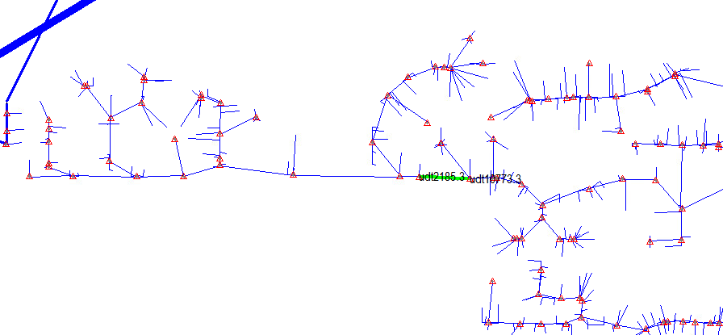
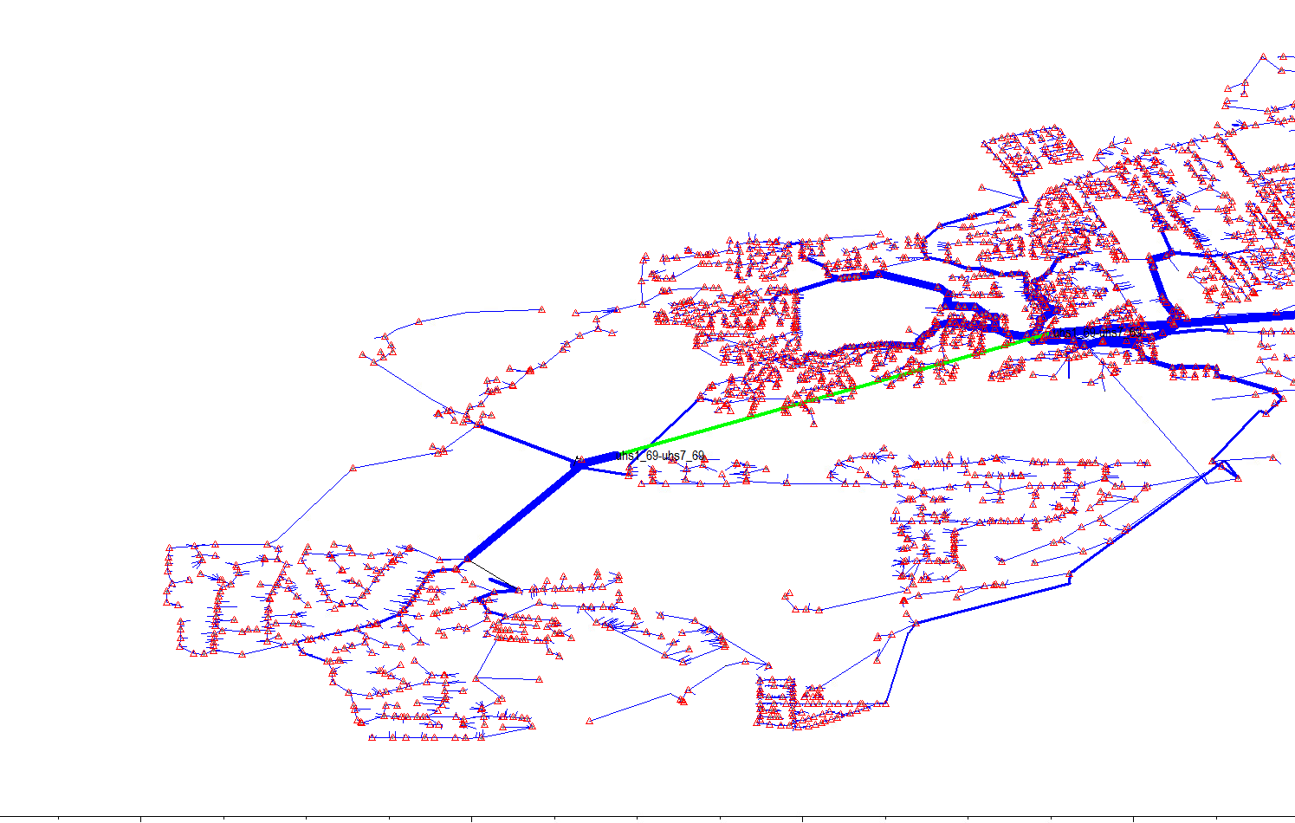
Tyler - Work
udt2185.3-udt10773.3
uhs1_69-uhs7_69

Slide 5
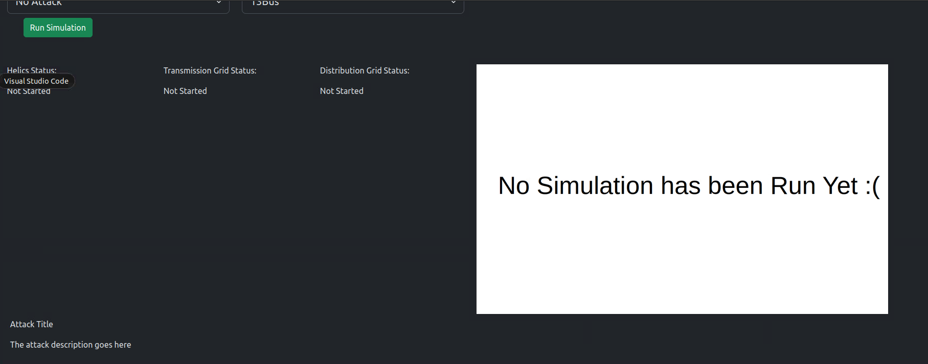
Zach - Work
Helped Matt add functionality to the pubsubgen.py to generate endpoints as well
Started working on adding more attack specific info to the deployment website (Struggling to get the attack description to sit in a reasonable spot)

Slide 6
Zach - Future Work
Get with Justin to work on the attack control lines
Rework the website to make it work better
Confirm with team list of attacks and brainstorm good descriptions
Start prep work for final presentation

Slide 7
Tommy - Work
Worked with Kaya and Matt on creating the connection between the transmission and distribution grid
Created a new transmission grid that fit the needs of a 220kV bus to connect with the distribution grid
Added two voltage/current monitors on the two xfmrs that were on the line connecting the santa fe subtransmission bus to the rest of the grid
To simulate pandapower with the current values from DSS, we needed to send complex power using helics.
Future Plans:
Help Matt with the EV load implementation onto the santa fe grid
Support Tyler and Zach with any attack questions

Slide 8
Matt - Work
Worked with Kaya and Tommy further on integration.
Modified Zach’s subscription and publication json generator to include endpoints for the charger configuration
Ran EV simulation with 500 EVs
Whenever I run it, it takes an extremely long time to finish the simulation
The graphs are also broken, I will need to figure out how to fix these (ChatGPT)
Working towards integration with HELICs EV load profiles and DSS-python
Working on a ChatGPT generated code that can export the data as CSV files
Future work:
Continue EV load integration and load creation in DSS-python with Tommy

Slide 9
Justin - Work
Finally got Kaya’s code to work on the Docker infrastructure.
Got graph dummy output to show on the frontend.
Helped Kaya with getting the real co-simulation up and running.
Got the real graph output to the Frontend
Recreated the frontend to work nicely with more images (2 columns vs 1)

Slide 10
Justin - Next Weeks Work
Help Zach with the Attack Control Lines (if needed)
Work on creating a zip file of all important graphs, data, etc to be shown on the frontend for users to download.

Slide 11
Kaya - Work
Worked with Tommy, Matt, and Justin on connecting pandapower, dss, and helics.
Figured out pandapower with Matt and Tommy.
Added monitors and got current from dss with Matt and Tommy
Got connected.
Calculating p_mw and q_mvar with pandapower and dss
Graphing the resulting p_mw and q_mvar, that gets output as a .png
Connected graph to frontend with Justin (not on master VM demo).

Slide 12
Kaya - Next Steps
Work with Matt to get the EV load on the grid.
Help Tyler/Zach with implementing their attacks on the grid.

Slide 13
Meeting Minutes

